Slide 1
RECOMMENDER SYSTEMS
Matrix Factorization vs.
Neural Collaborative Filtering
A Comparative Study on MovieLens 100K · Track B

Slide 2
What We'll Cover
1
Dataset Selection & Preprocessing
Why MovieLens 100K, and how the data was prepared
20 MINUTES
2
Model Design
Classical ML (SVD) vs. Deep Learning (NCF)
3
Evaluation & Validation
RMSE, NDCG@10, and k-fold cross-validation
4
Explainability Findings
SVD latent factors, SHAP & LIME on the neural model
5
Ethical & Bias Considerations
Privacy, fairness, and subgroup disparities
Two models, one dataset, one fair comparison.
6
Deployment Considerations
Taking either model from notebook to production
02

Slide 3
01 · DATASET
Why MovieLens 100K?
Spotify Tracks Dataset
MovieLens 100K
Considered, then ruled out
Selected dataset (GroupLens Research)
✗
Rich audio features (danceability, energy, tempo...)
✓
100,000 real user ratings — genuine collaborative signal
✗
No user-item interaction data at all
✓
Demographic + genre side information for XAI and bias analysis
✗
Collaborative filtering (SVD / NCF) has nothing to learn from
✓
Established academic benchmark — comparable to published results
Known limitation: 1997-98 data; not demographically representative of a modern audience. Revisited in Ethics.
03

Slide 4
01 · DATASET
Dataset at a Glance
943
1,682
100,000
~93.7%
Users
Movies
Ratings
Sparsity
The Long-Tail Problem
A small share of movies/users account for most ratings.
04

Slide 5
01 · DATASET
Preprocessing Pipeline
1
2
3
4
Raw IDs
Re-indexing
Per-User Split
Train / Test
Original user_id / item_id from u.data (1-indexed, gappy)
Dense, contiguous 0-based indices for embeddings & factor matrices
80/20 split within each user's ratings — avoids artificial cold-start
Every user appears in both sets; ready for modelling
Why per-user, not global random split? A single random split can accidentally leave some users out of training entirely — a genuine cold-start scenario neither model is designed to solve. Splitting within each user guarantees fair, comparable evaluation.
05

Slide 6
02 · MODEL DESIGN
Classical ML vs. Deep Learning
SVD
NCF
CLASSICAL ML
DEEP LEARNING
Bias-aware matrix factorization
Neural Collaborative Filtering (He et al., 2017)
Trained via SGD, from scratch (NumPy)
PyTorch embeddings + MLP
Linear latent-factor interactions
Non-linear interactions + side features
Seconds-to-minutes to train on CPU
Needs GPU-friendly pipeline, more tuning
06

Slide 7
02 · MODEL DESIGN
Classical ML — Regularised SVD
r̂ui = μ + bu + bi + puTqi
Key hyperparameters (validated via grid search)
n_factors
10 / 20 / 40 tested
reg
0.02 / 0.05 / 0.1 tested
global mean + user bias + item bias + latent-factor interaction
Why this model?
lr
0.01
The Netflix-Prize-style baseline: transparent structure, fast to train, still a strong production default across the industry.
epochs
30, with validation tracking
07

Slide 8
02 · MODEL DESIGN
Deep Learning — Neural Collaborative Filtering
User Embedding
(32-dim)
Item Embedding
(32-dim)
Genre Flags
(19-dim)
Age Embedding
(8-dim)
Concatenate -> 91-dimensional input vector
Dense(128) + ReLU + Dropout(0.2)
Dense(64) + ReLU + Dropout(0.2)
Dense(1) — predicted rating
08

Slide 9
03 · EVALUATION
How We Measure Success
RMSE
NDCG@10
Rating accuracy
Ranking quality
Penalises large rating errors heavily. Standard metric for explicit-feedback prediction; directly comparable to published benchmarks.
Evaluates whether the top-10 recommended items are the ones the user actually valued most — closer to real user experience than a raw error score.
09

Slide 10
03 · EVALUATION
K-Fold Cross-Validation
SVD: 5-Fold
Cross-Validation Results
train
train
VAL
train
train
SVD (5-Fold)
Mean CV RMSE: 0.9209
Standard Deviation: ± 0.0046
More consistent performance across folds.
NCF: 3-Fold
train
VAL
train
NCF (3-Fold)
Fold 1 RMSE: 0.9457
Fold 2 RMSE: 0.9294
Fold 3 RMSE: 0.9482
Mean CV RMSE: 0.9411
Standard Deviation: ± 0.0083
Fewer folds for NCF: each fold is a full neural-network training run with early stopping — a stated compute trade-off, not an oversight.
Key Finding
SVD's cross-validation RMSE (0.9209, ±0.0046) is both lower and far more stable than NCF's (0.9411, ±0.0083) — yet NCF wins on the single test set shown next. That reversal is the real finding here, not a contradiction to smooth over.
10

Slide 11
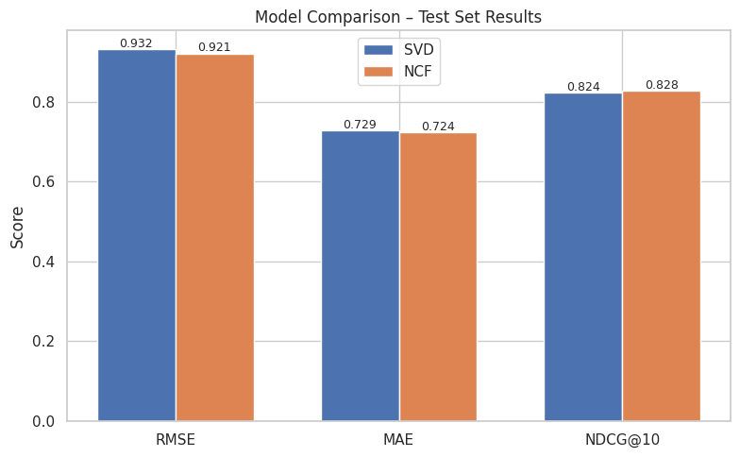
03 · EVALUATION
Model Comparison — Test Set Results
Key Findings
Lower RMSE/MAE = better rating accuracy
Higher NDCG@10 = better ranked recommendations
A model can win on one metric and lose on the other
This test-set win for NCF isn't statistically confirmed: a paired t-test on the CV folds gives p = 0.20 (t = -1.88).
11

Slide 12
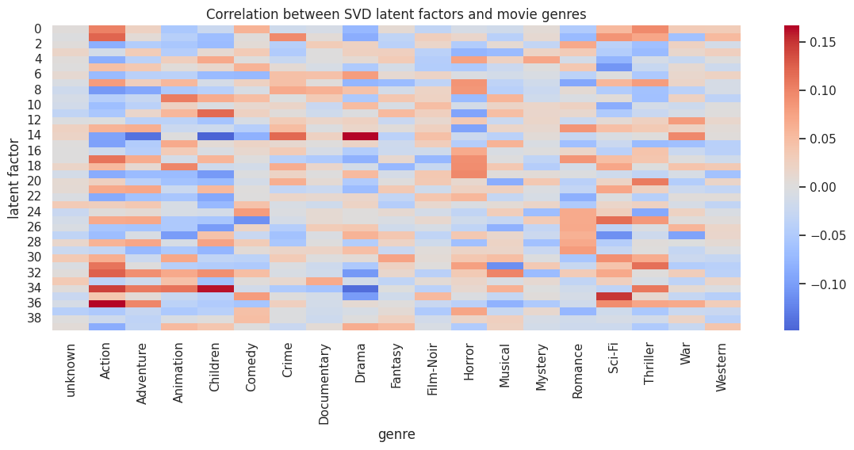
04 · EXPLAINABILITY
Explaining the Classical Model
Interpreting the Latent Factors
• Each latent factor represents a hidden pattern learned from user–movie interactions.
• Strong correlations with genres such as Action (0.17), Drama (0.16), Children (0.16) and Sci-Fi (0.15) show that the model captures meaningful preferences.
• This demonstrates that SVD learns interpretable representations without using genre labels during training.
12

Slide 13
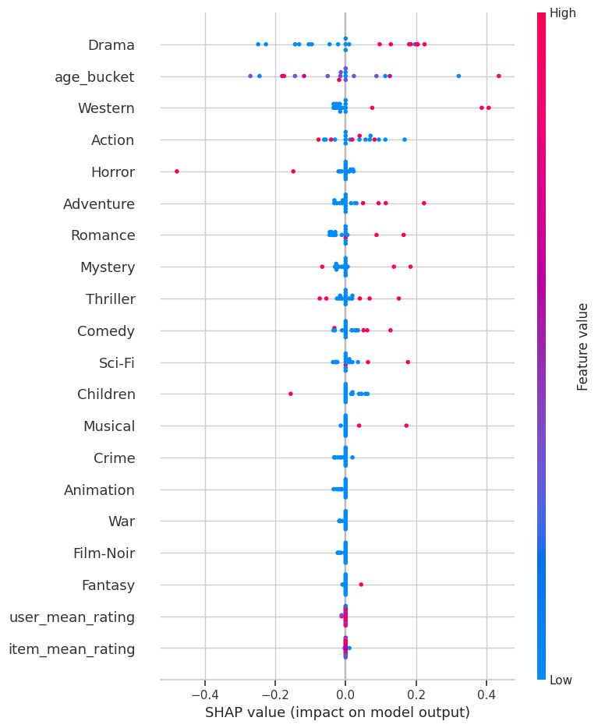
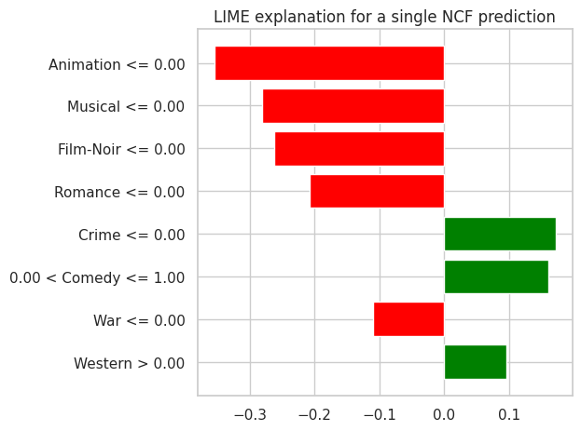
04 · EXPLAINABILITY
Explaining the Deep Model
Key Insights
• SHAP identifies the most influential features across all predictions.
• LIME explains individual recommendations.
• Together they improve transparency and trust in the NCF model.
13

Slide 14
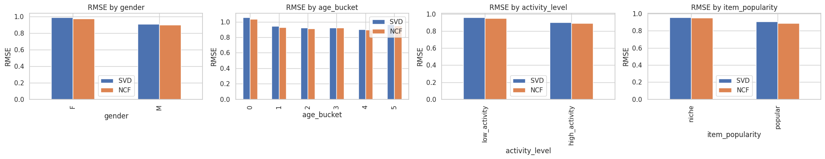
05 · ETHICS & BIAS
EXPLAINABILITY / FAIRNESS |
| Evaluating Fairness Across User Groups
Key Insights
Small RMSE differences across gender and age groups.
NCF achieved slightly lower RMSE for most subgroups.
High-activity users had lower prediction errors.
Popular items were easier to predict than niche items.
14

Slide 15
05 · ETHICS & BIAS
Ethical Considerations
1
2
3
Data Privacy
Algorithmic Fairness
Bias & Harm
Age + gender + ZIP code is a documented re-identification triple. Anonymised user IDs alone don't guarantee privacy.
False negatives suppress exposure to content — compounding over time into reduced visibility for niche films/creators.
Popularity bias + a non-representative 1997-98 cohort risk narrowing recommendations and under-serving minority groups.
15

Slide 16
06 · DEPLOYMENT
From Notebook to Production
Nightly batch
scoring
Key-value
store (cache)
Inference
API
Live
monitoring
Scheduled
retraining
Retraining loop — promotion gated by shadow-mode comparison against the current production model
Cloud platform: AWS SageMaker / Vertex AI / Azure ML — batch transform for nightly scoring, endpoint only if true real-time re-ranking is needed. Monitoring must include subgroup RMSE, not just aggregate accuracy.
16

Slide 17
06 · DEPLOYMENT
Overall Comparison: SVD vs. NCF
Dimension
SVD (Classical ML)
NCF (Deep Learning)
Accuracy
Strong
Higher ceiling, needs tuning
Training / inference cost
Low — seconds on CPU
Higher — GPU-friendly pipeline
Interpretability
High — direct factor inspection
Lower — needs SHAP/LIME surrogate
Cold-start handling
Poor — no side-feature mechanism
Better — genre/age wired in
Fairness auditability
Easier to audit & patch
Harder — diffused across params
Based on the experimental results, NCF is the preferred model due to its superior predictive performance on the test set. Nevertheless, SVD offers advantages in computational efficiency, stability, and interpretability, making it suitable for resource-constrained or highly explainable applications.
17

Slide 18
KEY TAKEAWAYS
Neither model is a free-standing winner — the right choice depends on which trade-off (accuracy, cost, interpretability, fairness) matters most for the deployment context.
Fairness problems here are as much about the data (long-tail sparsity, cohort skew) as about the model — switching architectures alone won't fix them.
Explainability is achievable for both model families, but requires a different technique for each — direct factor inspection for SVD, surrogate SHAP/LIME for NCF.
Thank You
19

